Slide 1
Digital Portfolio
STUDENT NAME:T KUMAR
REGISTER NO AND NMID:20924U09092/ astvu20920924u09092
DEPARTMENT:BCA
COLLEGE: COLLEGE/ UNIVERSITY SHANMUGA INDUSTRIES ARTS & SCIENCE COLLEGE / THIRUVALLUVAR UNIVERSITY

Slide 2
PROJECT TITLE
Digital portfolio for own business using html, css and JavaScript

Slide 3


AGENDA
Problem Statement
Project Overview
End Users
Tools and Technologies
Portfolio design and Layout
Features and Functionality
Results and Screenshots
Conclusion
Github Link
3/21/2024 Annual Review

Slide 4

PROBLEM STATEMENT
Many businesses struggle to showcase their work online in a professional and engaging way.
Lack of a digital portfolio limits opportunities to attract clients and build credibility.
There is a need for a simple, modern, and interactive portfolio solution to highlight skills and projects effectively.

Slide 5

PROJECT OVERVIEW
This project is about developing a personal digital portfolio website using HTML, CSS, and JavaScript.
The portfolio will feature sections for About, Projects, and Contact, with a modern black-themed design.
It aims to provide a professional online presence and make it easier for clients to connect

Slide 6

WHO ARE THE END USERS?
Freelancers and professionals who want to showcase their skills and work online.
Businesses and startups needing a digital presence to attract clients.
Students and job seekers creating portfolios to highlight projects and achievements.

Slide 7

TOOLS AND TECHNIQUES
HTML, CSS, and JavaScript for creating a responsive and interactive digital portfolio.
Visual design techniques with a modern black theme for a professional look.
Integration with WhatsApp for seamless client communication

Slide 8
POTFOLIO DESIGN AND LAYOUT
Black background theme with clean, modern typography for a professional look.
Structured sections: Home, About, Projects, and Contact for easy navigation.
Responsive layout ensuring accessibility across desktop and mobile devices.
8

Slide 9
FEATURES AND FUNCTIONALITY
User-friendly design with smooth navigation.
Interactive sections for About, Services, and Contact.
Integrated WhatsApp link for instant communication.

Slide 10
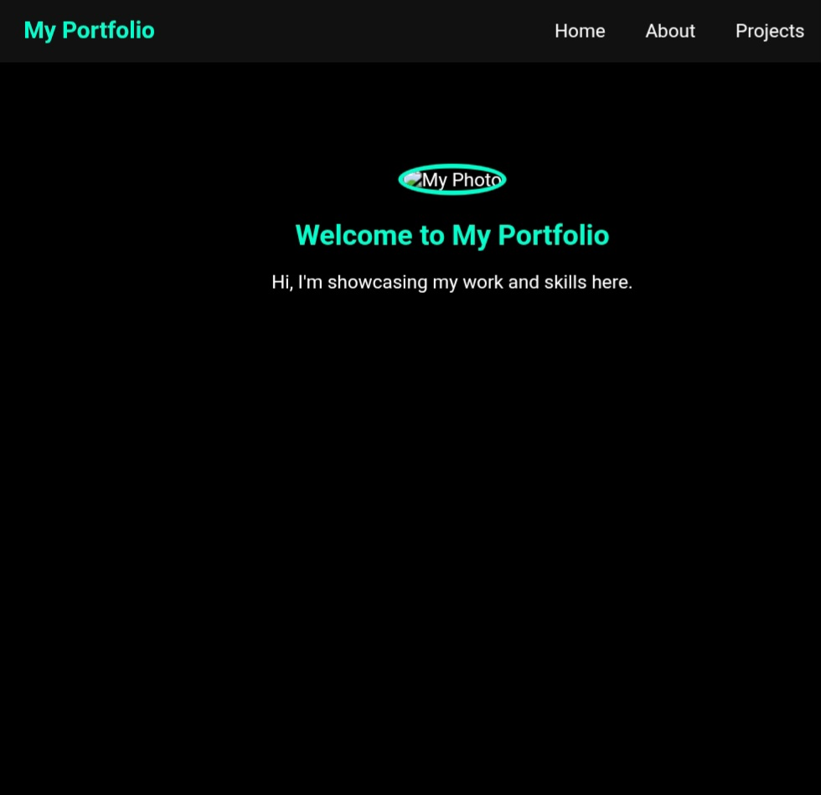
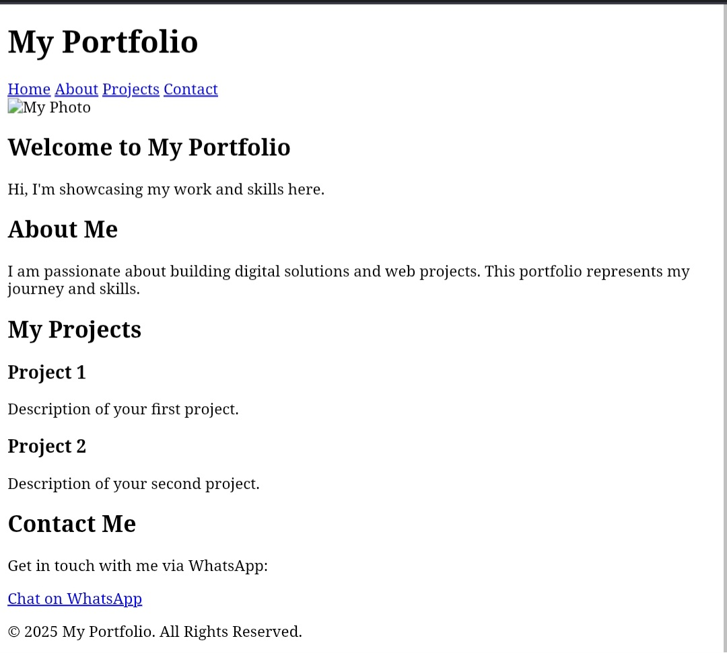

RESULTS AND SCREENSHOTS
Screenshot of each section.
Before VS After(plain HTML->With css and javascript.
3/21/2024 Annual Review
10

Slide 11
CONCLUSION
Digital portfolio program helps users showcase their skill and projects esily.
It improves carrer opportunities by poviding a professional digital portfolio.
11

